Slide 1

Integrated Payments Solution

Slide 2
Content Summary
Product Overview
Solution Overview
Sample Screens
User Roles & Functionalities
Security Features
Technology Stack

Slide 3
Product Overview

Slide 4
Product Overview
Money Transfer Services is a huge and exponentially growing market. In 2015 a whopping $515 Billion was remitted between immigrants in their respective countries. However in the Middle East, this largely is an untapped market.
Remittance in the Middle East is largely dominated by traditional money transfer services such as Western Union, MoneyGram & Inter Bank Transfers.
These services are not competitive compared to services offered in the global market. As an example a normal transfer of £1,000 into Euros using Western Union can cost over £100 once you add in exchange rates and other fees, whereas through a bank wire transfer cost £50, where as we can offer the same transfer at an attractive rate of £4.50, a direct savings of at least over £45.
We are able to provide such substantial savings by leveraging the latest advances of emerging technologies in FinTech sector.
* Except UAE & Bahrain
Notes:
Centralized Core System - Transaction Processing, Database, Payments Connectivity and Reporting for remittance & bill payment
B2B, B2C interfaces – B2B – mawarid-with other EH
B2C – customer with mawarid – online portal
Multiple bill payment options - Direct Debit, credit card
The application facilitates, manages and interfaces with third party systems for user to make remittance, bill payments and top ups
The system will support single point connectivity to multiple billers through a secure payment switch
The application provides detailed reports on transactions to Mawarid & its partners
It provides an integrated content management system for the administrators to manage the user interfaces
There should be a core system for managing all interfaced solutions centrally, securely and effectively

Slide 5
Product Overview
Key Advantage of applicationNAme
You get the real exchange rate: Money transfer leaders like MoneyGram, Western Union & Banks set their own exchange rate to make money off the customer. Say goodbye to hidden fees and hello to transparency
You will always know where the money is: We keep you updated at every stage of the transfer. Secure, Authorized & Regulated.
Receive Smart Notifications: Our proprietary algorithm monitors the exchange rates in real time and notifies you when a significant event happens
* Except UAE & Bahrain
Notes:
Centralized Core System - Transaction Processing, Database, Payments Connectivity and Reporting for remittance & bill payment
B2B, B2C interfaces – B2B – mawarid-with other EH
B2C – customer with mawarid – online portal
Multiple bill payment options - Direct Debit, credit card
The application facilitates, manages and interfaces with third party systems for user to make remittance, bill payments and top ups
The system will support single point connectivity to multiple billers through a secure payment switch
The application provides detailed reports on transactions to Mawarid & its partners
It provides an integrated content management system for the administrators to manage the user interfaces
There should be a core system for managing all interfaced solutions centrally, securely and effectively

Slide 6
Solution Overview

Slide 7
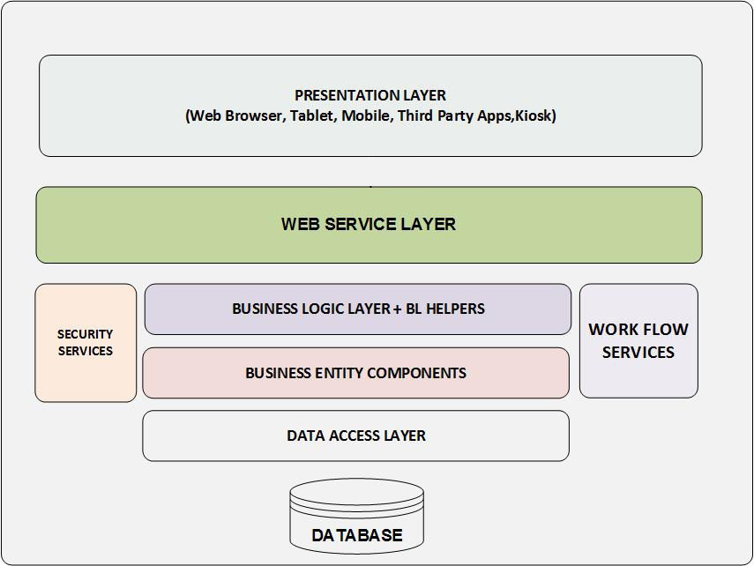
Solution Architecture
Notes:
BL helpers - business logic helpers are reusable components

Slide 8
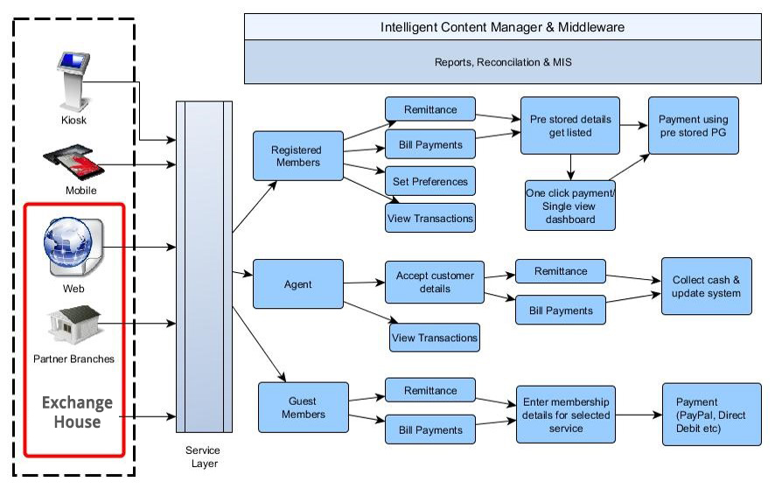
Solution Landscape
The diagram depicts a high-level overview of the solution

Slide 9
Solution Description - Remittance
Solution
Back-end connectivity to multiple exchange houses having different back-end systems
Beneficiary list stored in the respective EH will be fetched
Direct remittance using the online interface via Kiosk, Web and Mobile
Registered customers can save preferred exchange house details
Archive transactions for reporting
Key Features
The key features include:
Acknowledgement and Receipts
Reporting, Reconciliation & MIS
Transaction history
Notes:
Remittance
The remittance functionality would be designed to enable customers to conduct remittance transactions through Mawarid, using the web and/or mobile channels
The entire solution should be managed centrally through a single back-end, that would facilitate interfaces to the 3rd parties concerned and also centralized reporting

Slide 10
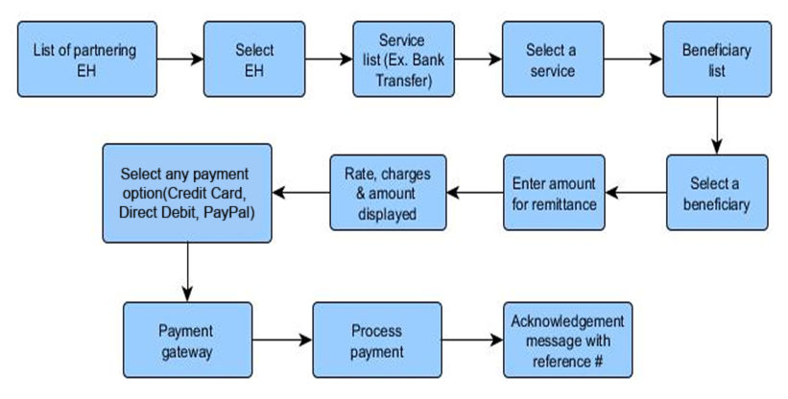
Solution Description – Remittance Non Registered Customer (B2C)

Slide 11
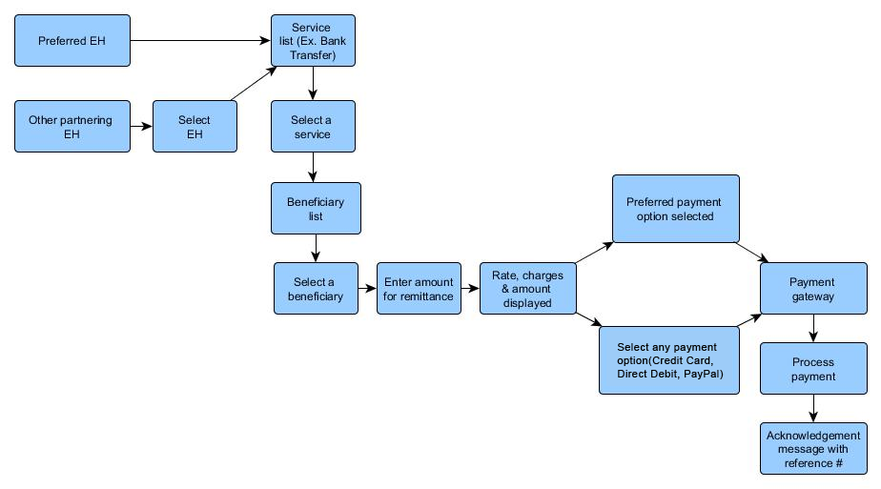
Solution Description – Remittance Registered Customer (B2C)

Slide 12
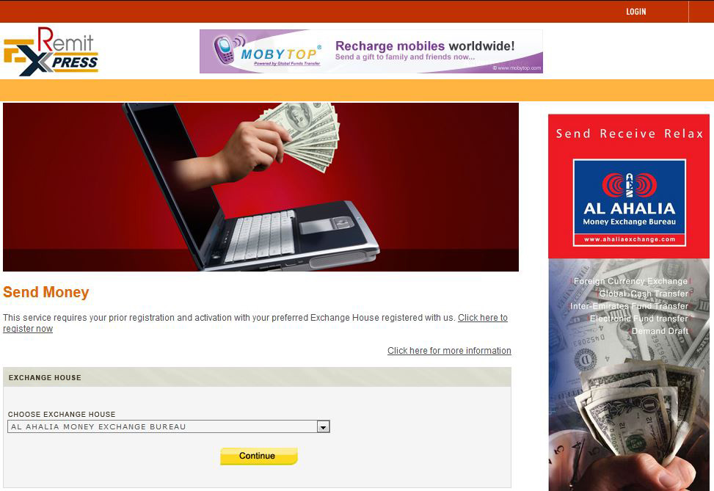
Screenshots – Remittance
Notes:
Selecting EH for a non registered customer

Slide 13
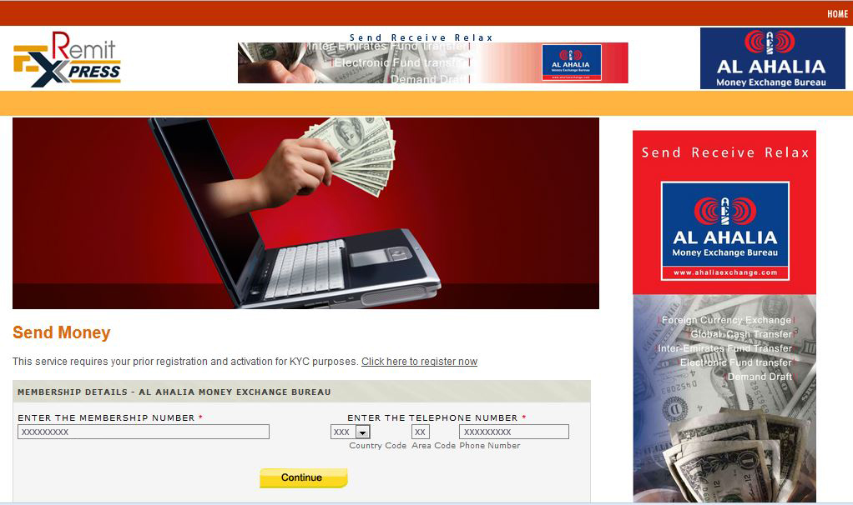
Screenshots – Remittance

Slide 14
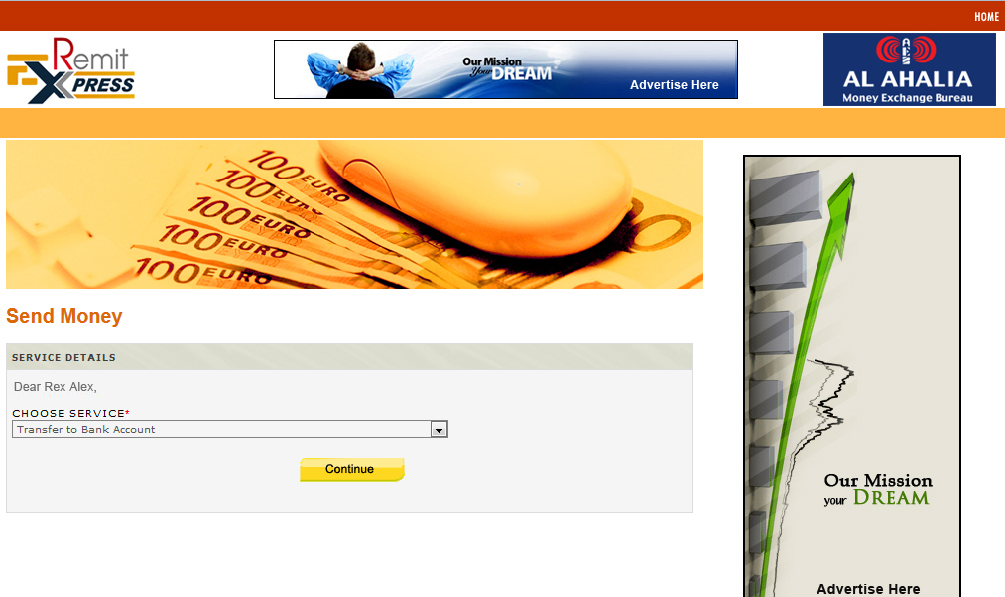
Screenshots – Remittance

Slide 15
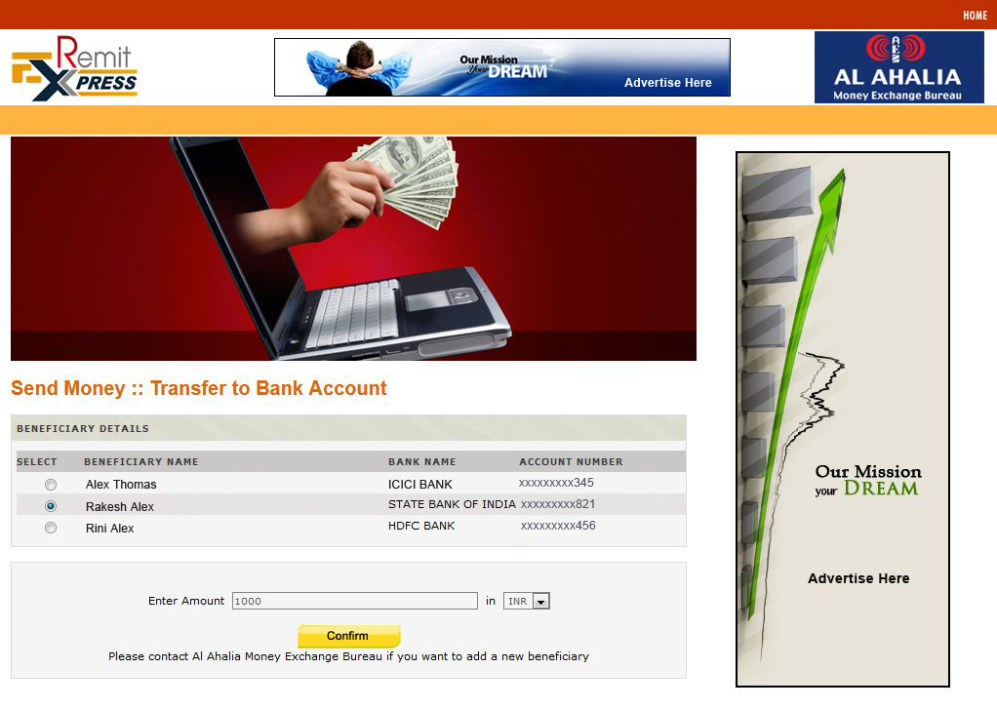
Screenshots – Remittance

Slide 16
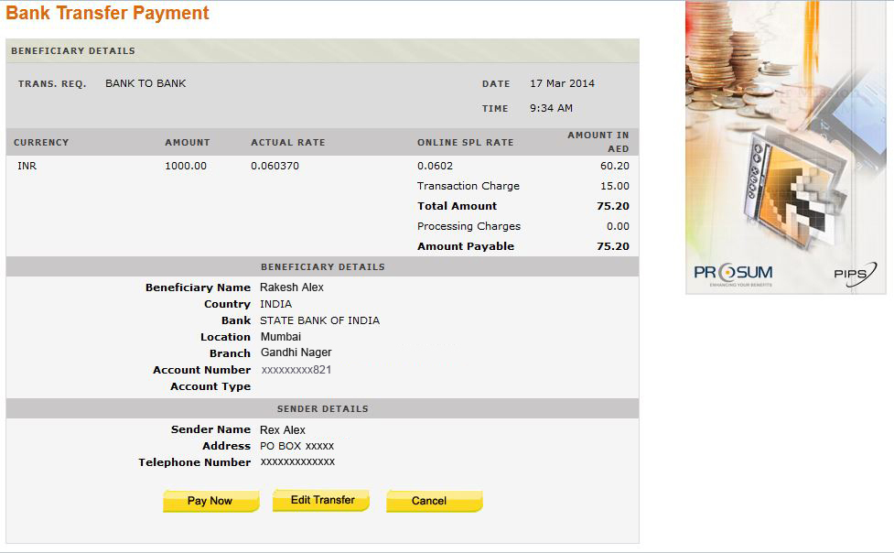
Screenshots – Remittance

Slide 17
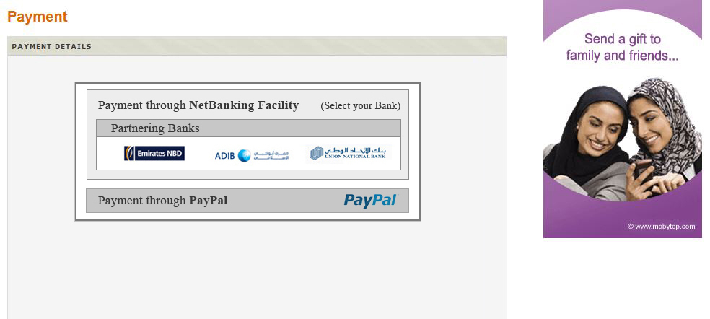
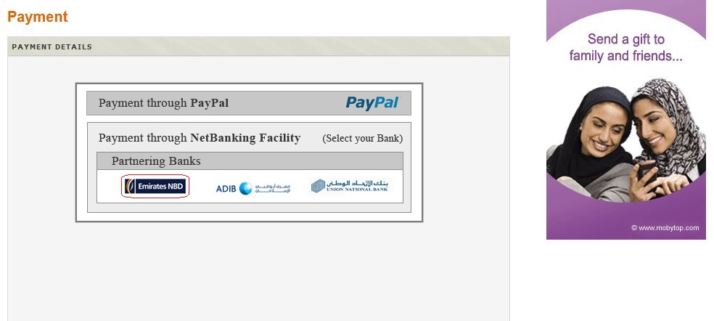
Screenshots – Remittance
Payment method chosen is Net banking
Notes:
Non registered customer has to select the payment option

Slide 18
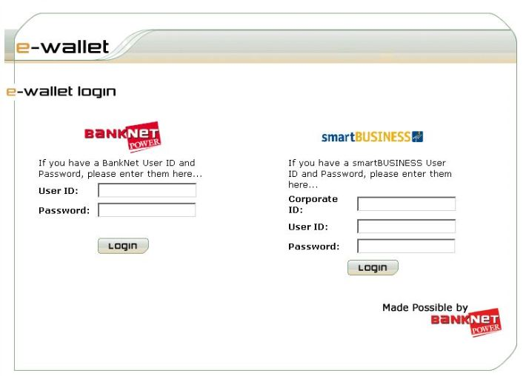
Screenshots – Remittance

Slide 19
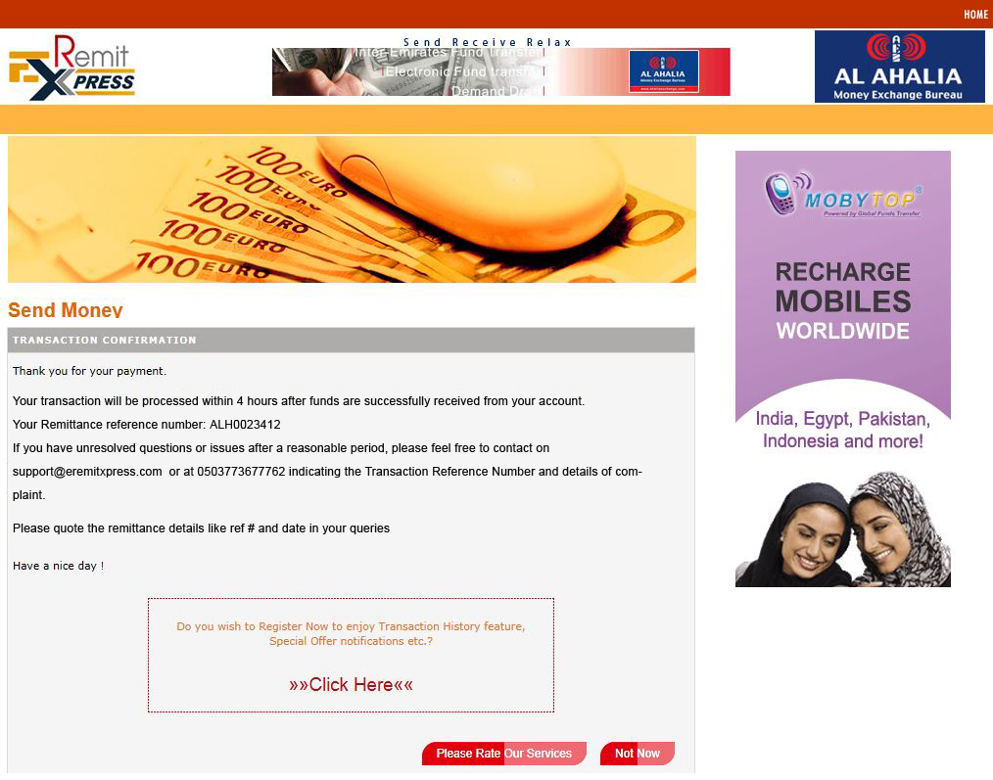
Screenshots – Remittance

Slide 20
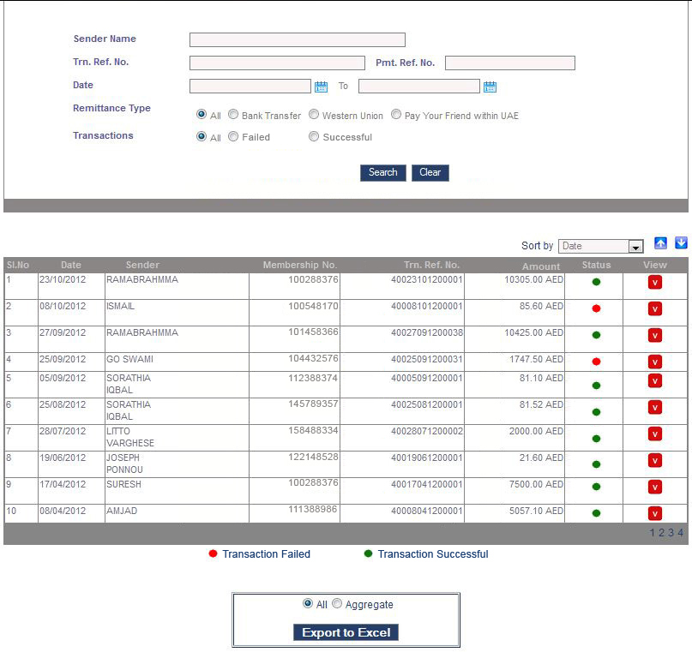
Screenshots – Remittance
Remittance transaction summary – Partner EH (admin)
Notes:
Payment ref no. – given by bank
Txn ref no. – system generated
When aggregate is selected the total amount corresponding to a particular EH for the selected period will be available

Slide 21
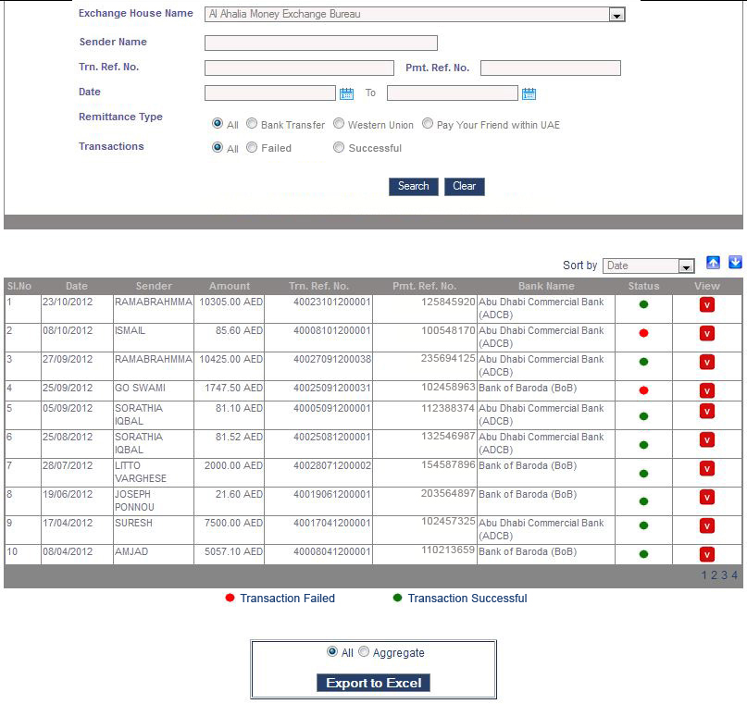
Screenshots – Remittance
Remittance transaction summary – admin
Notes:
Payment ref no. – given by bank
Txn ref no. – system generated
When aggregate is selected the total amount corresponding to a particular EH for the selected period will be available

Slide 22
Users – Roles & functionality
The different users of the solution are:
Administrator
Manage Admin Users
Manage Permissions
Manage Branch / Agent / Staff Users
Manage Charges
Manage Exchange Houses
Manage Partnering Billers
Manage Partnering Schools
Manage Partnering Airlines
Manage Mobile Top-up Companies
Manage Utility companies
Manage Messages
View Transactions
Setting Transaction limit
Agent/Staff
Conduct Transaction
View Transactions
Customer
Edit Profile
View Transactions
Set Preferences

Slide 23
Web Services Layer
Web service layer will be the interface between the presentation layer which handles the different payment modes and the business layer which houses the payment processing components.
Features
Interoperability - virtually platform-independent.
Usability - allows the business logic of multiple systems
Reusability - reuse Web Service components as appropriate in other services. Makes it easy to deploy legacy code as a Web Service.
Deployability - Web Services are deployed over standard Internet technologies. Uses proven community standards, with built-in security (such as SSL).
Benefits
Eliminates Dependency
Reduces time
Cost savings
Notes:
Reusability reduces time. Since the same web service can be extended to cater different payment channels.

Slide 24
Security Features
Data encryption
Authentication
Authorization
Prevention of Application Vulnerabilities
Communication Security
Data Access Security
Auditing

Slide 25
Technology Stack

Slide 26
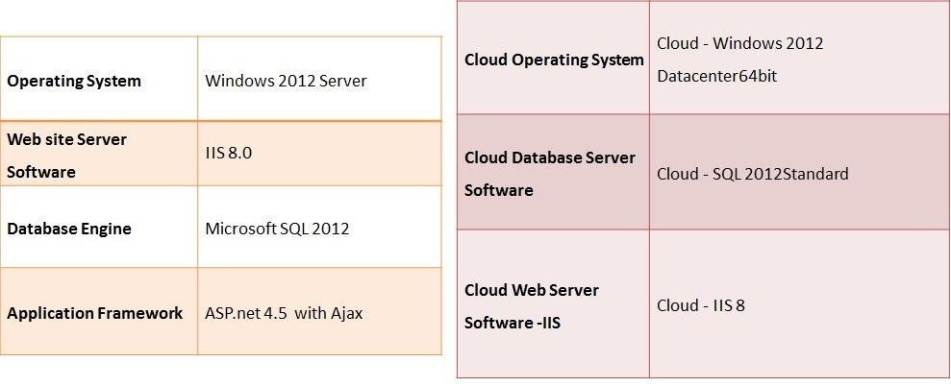
Technical Specification & Server requirements

Slide 27
Thank you

